Slide 1
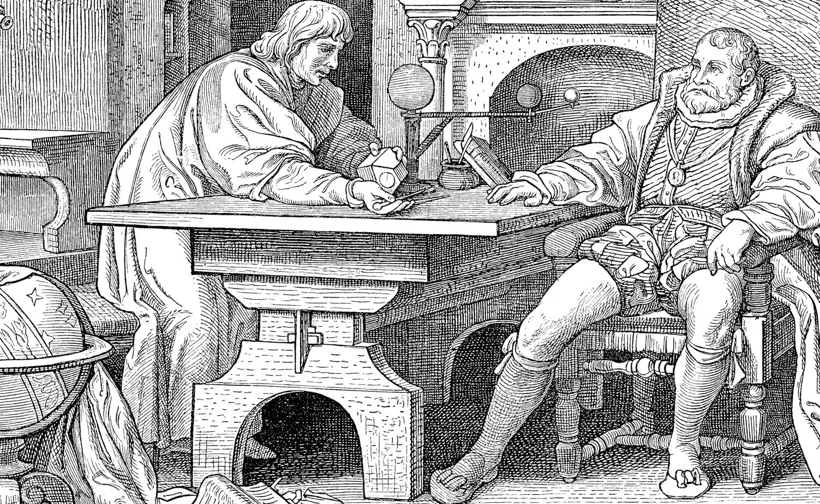
The new astronomy
Ben Gehl
MATH 4044

Slide 2
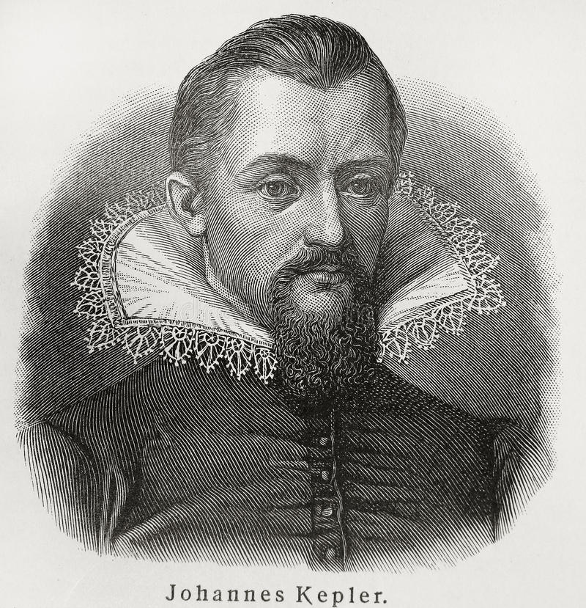
Early life
Born December 27th around 1pm in Weil der Stadt. (HRE).
Poor and sickly at birth but noticeably intelligent.
Earned a scholarship to Tubingen University to study Lutheran theology.
Loved Copernican ideals, changed academic path.
Mysterium Cosmographicum
Alienated between two churches.
After school I got a position teaching at Graz. (seminary school)

Slide 3
Becoming an adult
1596 - I denounced my family affiliation, Augsburg Confession, Lutheranism and denied conversion to Catholicism, which was a major conflict at the time. Forced to leave my post at Graz. These events coincided with the counter Reformation!
1601 - Met Danish astronomer Tycho Brahe. Became good friends and inherited his post at imperial mathematician in Prague as well as his precise data.
1609 – published Astronimia Nova, my first two laws of planetary motion
1612 – forced out of Prague due to religious unrest.
1619 – Harmonices, my third law of planetary motion.

Slide 4
Later life
1621 – after fleeing Prague, published Epitome Astronomiae which gave a systematic way to describe heliocentric astronomy.
Rudolphine Tables – maps of the starry sky envisioned by Tycho Brahe.
I used logarithms to and these tables to calculate planetary positions for past and future dates.
This was my greatest accomplishment, and I didn’t get to see the calculations work since many of the events, like the movement of Mercury and Venus over the sun, did not happen during my lifetime!
1630 – I died November 15th at the age of 58 in the free imperial city of Regensburg, my grave would be destroyed during 30 years war

Slide 5
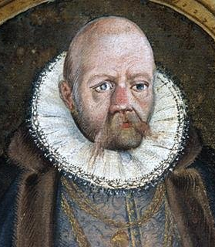
My prized work Astronomia Pars optica
Explaining planetary motion which evolved into celestial mechanics and natural laws.
Advanced optics in pursuit of better astronomical calculations.
Explained how humans' eyes work. (refraction)
Eyeglasses for near and far sighted.

Slide 6
Continued
DIOPTRICE - The study of refraction of light by lenses. Which was used to explain telescope's functionality.
STEREOMETRICA DOLIORUM – basis for integral calculus.
I explained how the tides were caused by the moon which was refined by Galileo.
Used Earth’s orbit (stellar parallax) to attempt measurements of the distance to stars. Which evolved into a whole branch name “astrometry” – based on the ideas of depth perception.
Coined the term satellite, derived logarithms mathematically and I was the first to derive the year Christ was born.

Slide 7
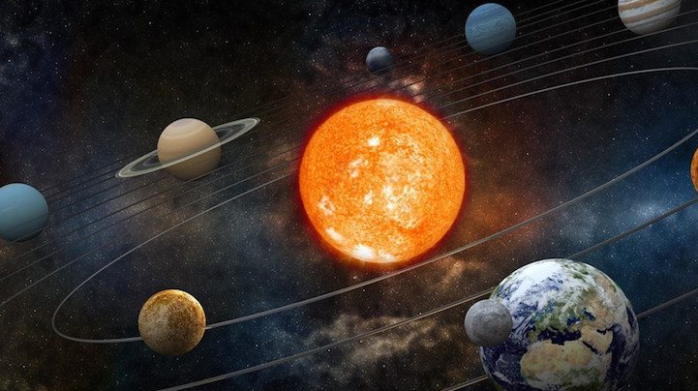
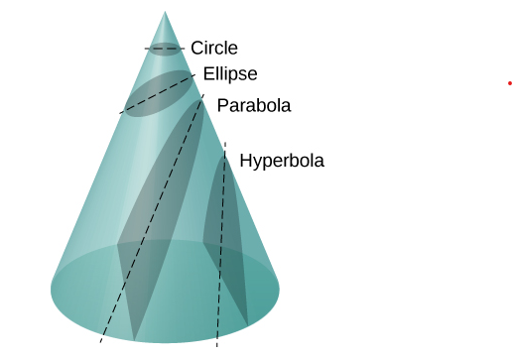
Laws of Planetary motion First Law
All planets move about the Sun in elliptical orbits, having the Sun as one of the foci.
formula for an ellipse: a / r = 1 + e cos(theta)
Where a and e are constants determined by total energy and angular momentum.
These two values determine which of the four conic sections the satellite path is.
We can now define this ellipse as the set of points whose sum are a and e.
NOTE: there are cases where the foci overlap, creating just one foci. This means they share a common center of mass.
r – distance between the two massive bodies (satellite and the sun)
Theta – angle from x –axis and major axis of ellipse.

Slide 8
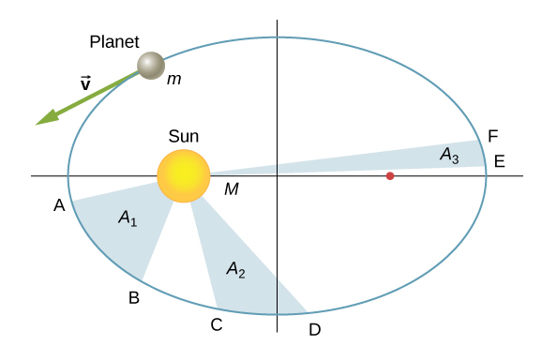
Laws of Planetary motion second Law
L⃗ =r⃗ ×p⃗ =r⃗ ×(p⃗ rad+p⃗ perp)=r⃗ ×p⃗ rad+r⃗ ×p⃗ perpL→=r→×p→=r→×(p→rad+p→perp)=r→×p→rad+r→×p→perp.
A radius vector joining any planet to the Sun sweeps out equal areas in equal lengths of time.
Using the definition of Angular Momentum, L = r x P (r is position vetor, p = mv), I solved for two components. We know that P will always be tangential to the ellipse since the planets are moving along the ellipse.
We then take the cross product:
L⃗ =r⃗ × p⃗ =r⃗ × (p⃗ rad + p⃗ perp)=r⃗ × p⃗ rad + r⃗ × p⃗ perp .
Angular momentum does not depend on P (rad) (since it points towards the sun each time), thus r is parallel to P (rad):
L = rmv(perp) which newton will show is a consequence of law of gravitation.

Slide 9
Laws of Planetary motion second Law
L⃗ =r⃗ ×p⃗ =r⃗ ×(p⃗ rad+p⃗ perp)=r⃗ ×p⃗ rad+r⃗ ×p⃗ perpL→=r→×p→=r→×(p→rad+p→perp)=r→×p→rad+r→×p→perp.
Now, consider a small triangle area A swept out in time t.
The velocity is along the same path, so v(perp) = v sin(theta).
I assumed the planet moves s = v*t*sin(theta), which I understand as a projection along the direction perpendicular to r.
Then I simply used the area of a triangle (1/2 b h) to calculate the area of this displacement.
A = ½ r * s = ½ r (v * t * sin(theta) = 1/2m * r (m * v * sin(theta) * t)
= L / 2m * t = AREAL VELOCITY
L = angular momentum , m = mass, t = time, v = velocity

Slide 10
Laws of Planetary motion Third Law
T=2πr3GME−−−−−√.T=2πr3GME.
The squares of the sidereal periods (of revolution) of the planets are directly proportional to the cubes of their mean distances from the Sun.
T = 2 * (PI) * sqrt( r^3 / Gme )
This is a period of circular orbit of radius r about Earth. Now lets use an ellipse from before. R is a (constant)
T^2 =( 4 (pi)^2 / GM ) * a^3
This was used to calculate the orbit of Halley’s comet!

Slide 11
Books, articles, pictures
Book:
Voelkel, J. R. (1999). Johannes Kepler and the new astronomy. Oxford University Press.
Article:
Russell, J. L. (1964, January 1). [PDF] Kepler's laws of planetary motion: 1609–1666: Semantic scholar. undefined. Retrieved December 7, 2021, from https://www.semanticscholar.org/paper/Kepler%27s-Laws-of-Planetary-Motion%3A-1609%E2%80%931666-Russell/3a2e7e792fc7662b4125b2f3649d568d0a0a45c2.
Pictures:
Bellis, M. (2019, May 15). Biography of Johannes Kepler, pioneering German astronomer. ThoughtCo. Retrieved December 7, 2021, from https://www.thoughtco.com/johannes-kepler-astronomy-4072521.

