Slide 1
History of Math: Guess the Mathematician !
Rachelle Hart

Slide 2
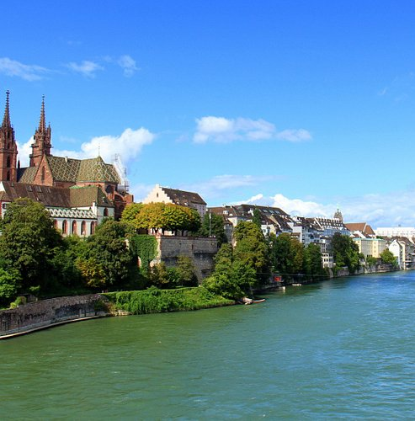
Early Life
Belgium family background, but born in Basel, Switzerland in 1654
Eldest son of his family
Wanted to study mathematics
Father expected him to study theology and become a minister

Slide 3
Education
Studied theology and philosophy at Basel University
Graduated with master’s and obtained a licentiate

Slide 4
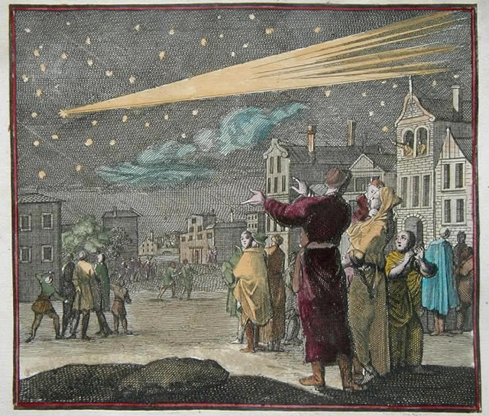
Career Change
2 Events:
France trip and Descartes’ followers
The Great Comet in 1680
“Against my father's will, I will turn to the stars”

Slide 5
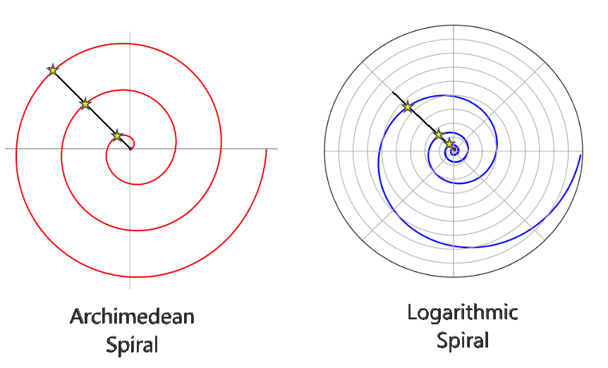
Fun Fact: Final Wish
Studied caustic curves and logarithmic spirals
Wished for a logarithmic spiral on tombstone but got an Archimedean instead
“I shall arise the same though changed”

Slide 6
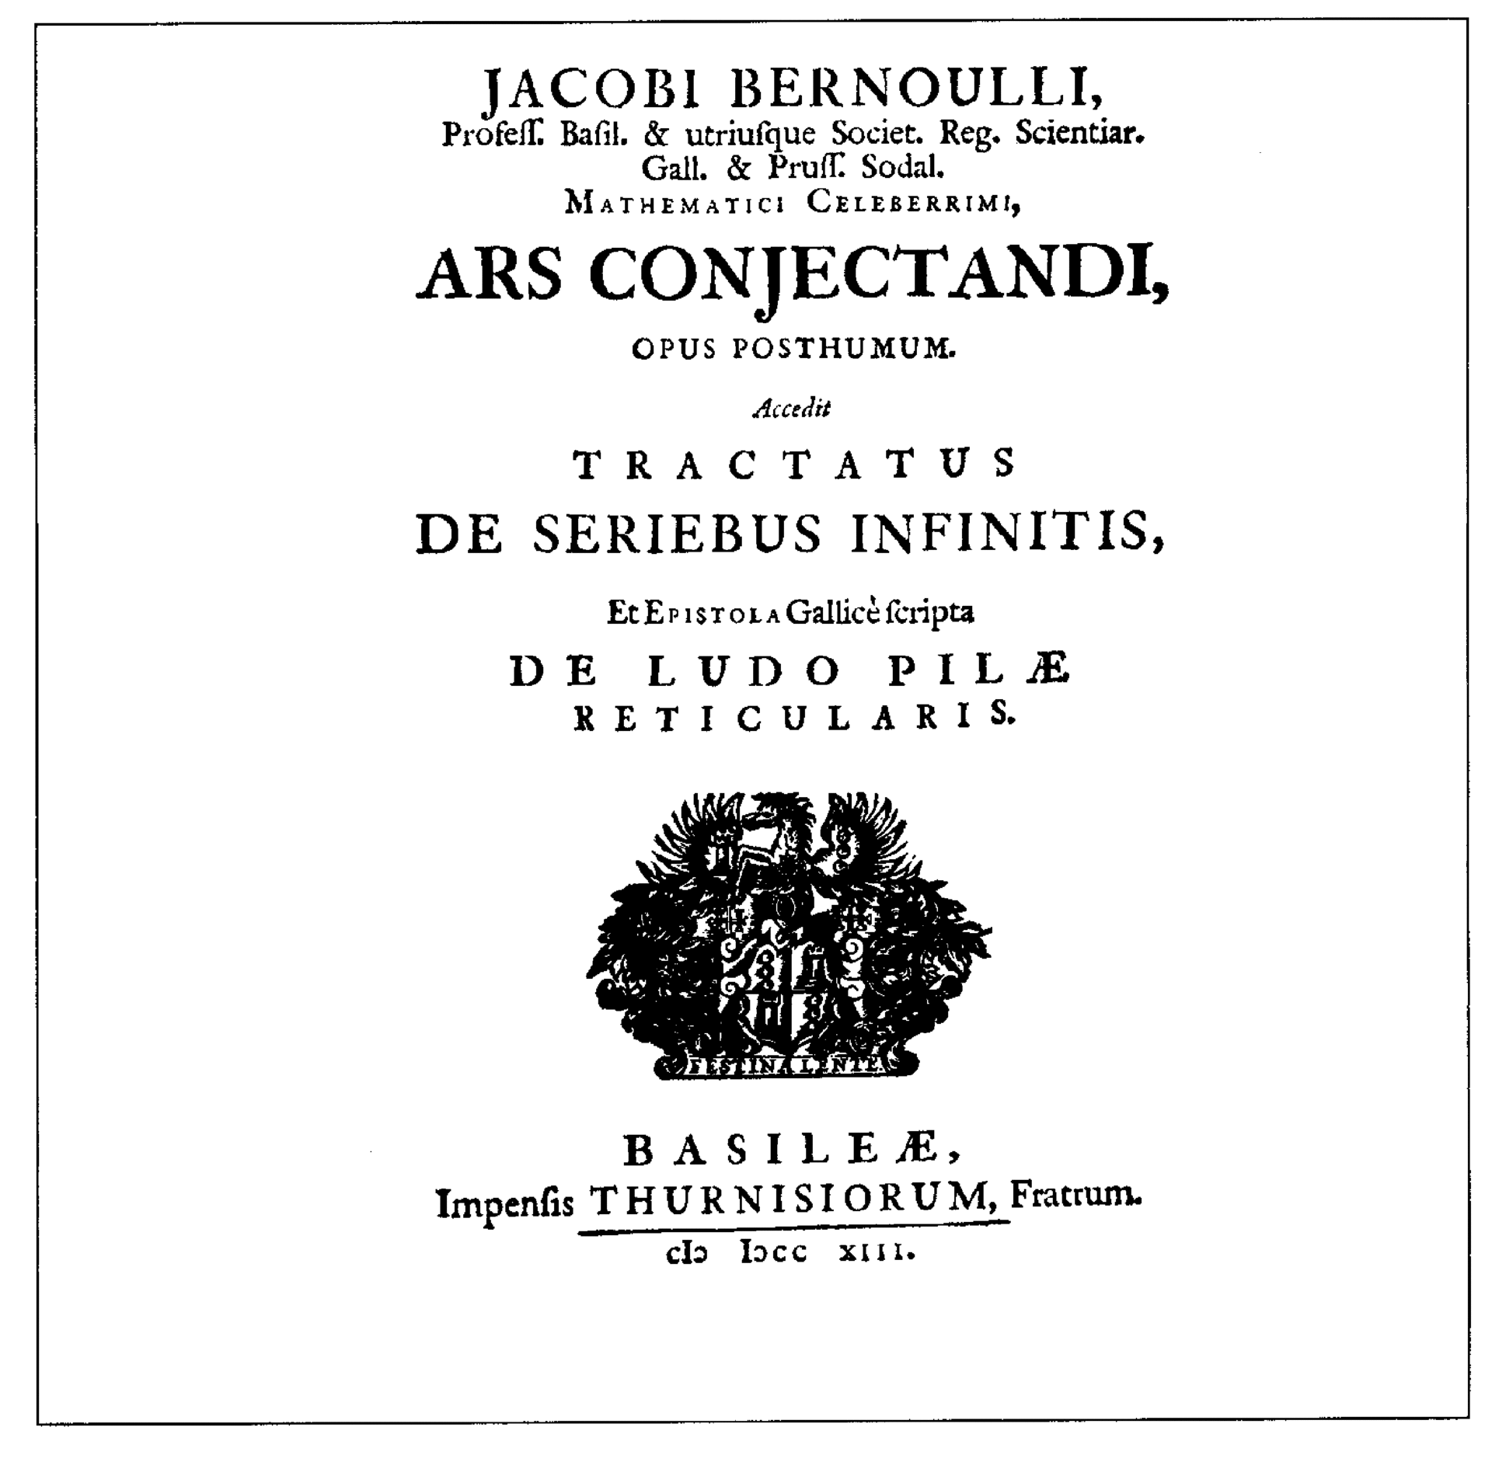
His Final Work
1713 (after his death!)
“The Art of Conjecturing”
His nephew helped publish it
Took 8 years after his death to get it published

Slide 7
_______ Numbers
$\frac{t}{e^{t}−1}= \sum_{n≥0}{\frac{B_{n}t^{n}}{n!}}$ where $\left|t\right|<2π$
Bn = sequence of rational numbers
Found while finding the sum of consecutive integer powers

Slide 8
______ Numbers 2

Slide 9
______ Numbers 3

Slide 10
______ Numbers 4

Slide 11
______ Numbers 5

Slide 12
______ Numbers
Explicit Formula
$B_{n}= \sum_{k=0}^{n}{\frac{1}{k+1}}\sum_{v=0}^{k}{{\left(−1\right)}^{v}}\left({k \atop v}\right)v^{n}$ for $n≥0$
Applications
https://www.desmos.com/calculator/mbvcny6jsx

Slide 13
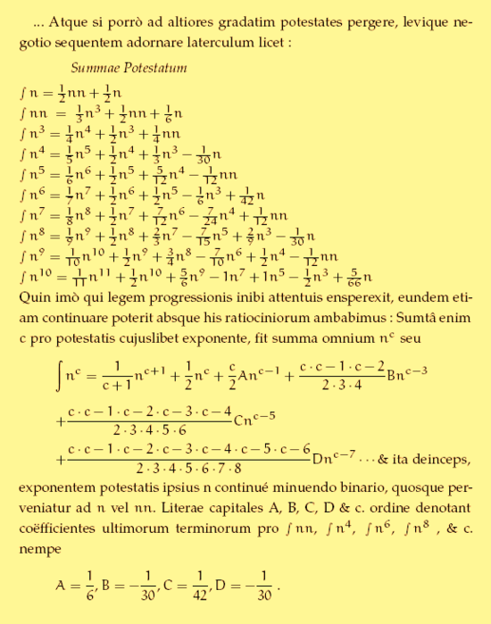
His Numbers

Slide 14
Who Am I?

Slide 15
Bernoulli! But which Bernoulli family member?

Slide 16
Jacob (aka James) Bernoulli !

Slide 17
Sources
https://link.springer.com/content/pdf/10.1007/s00283-021-10072-y.pdf
https://link.springer.com/article/10.1007/s00283-021-10072-y
https://www-oxfordhandbooks-com.ezproxy.lib.vt.edu/view/10.1093/oxfordhb/9780199607617.001.0001/oxfordhb-9780199607617-e-4
https://www.britannica.com/biography/Jakob-Bernoulli
https://mathshistory.st-andrews.ac.uk/Biographies/Bernoulli_Jacob/
https://ebookcentral.proquest.com/lib/vt/reader.action?docID=1633329#
https://www.whitman.edu/documents/Academics/Mathematics/2019/Larson-Balof.pdf

