Slide 1
Mathematician Project
Jean Baptiste Joseph Fourier

Slide 2
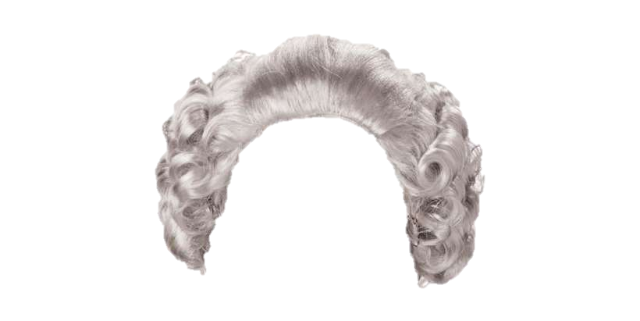
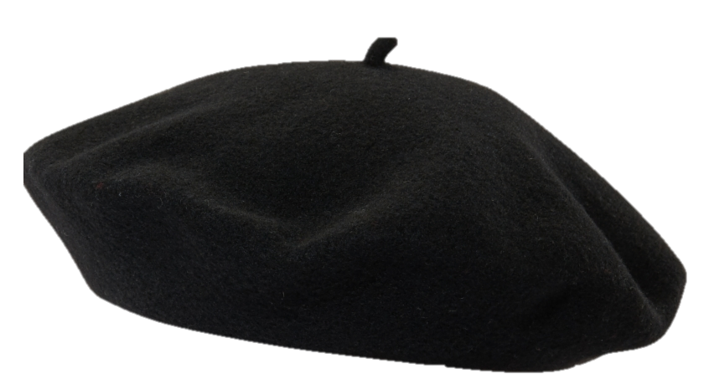
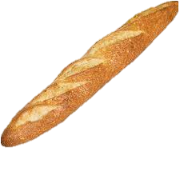
Early Life
Our mathematician was born in the province of Yonne, France on the 21st of March 1768.
He was the 19th but not final child!
If he were alive today, there would be a TLC series on his family.
At 9 years of age, both his parents had passed away and he was taken care of by a certain Madame Moitton.
After failing to join the military as an engineer, he instead chose to teach at the Benedictine abbey of St. Benôit sur Loire in 1787.

Slide 3
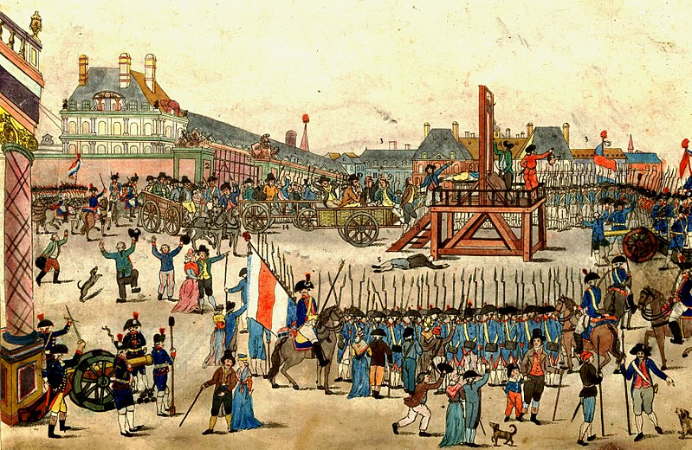
Young Adulthood
As an adult Joseph joined the Société Populaire, an arm of the Jacobins.
In 1794, he was imprisoned and to be guillotined as part of the Reign of Terror.
Before he could meet his maker Robespierre got axed, both figuratively and literally, granting him amnesty

Slide 4
École Polytechnique
Afterwards Joseph, was appointed to an assistant teaching post at the École Polytechnique.
Created a new proof of Descartes Rule of Signs.
Was asked by his colleague Gaspard Monge to accompany Napoleon Bonaparte to his Expedition to Egypt.

Slide 5
Middle Years
Joseph was later appointed to several diplomatic positions, which greatly hampered his ability to pursue mathematics.
Despite his arduous duties as prefect of Isère, in 1811, Joseph published his paper “Théorie de la Propagation de la Chaleur”.
Translated title is “Theory of the Diffusion of the Heat”.
This is when the wider mathematical world was first introduced to Joseph’s namesake series. The series can represent all periodic signals using trigonometric functions rather than cumbersome piecewise equations.

Slide 6
Fourier Series
Consider the example given by Joseph in Art 46 of the 1805 draft of his Théorie:
https://www.desmos.com/calculator/7a8usdhfrq

Slide 7
Final Years
Joseph died in 1830
Now back to the Fourier Series and the Fourier Transform.

Slide 8
Reinterpreting Signals
As we mentioned earlier the Fourier Series allowed for periodic functions to be represented as trigonometric functions. This allows us to represent certain signals like the sawtooth, square, or triangle waves as sine waves in the time domain.
This raises some questions; how do we use Joseph’s namesake series to represent functions in the frequency domain? What about non-periodic functions, how are they represented?
That is where the Fourier Transform can be used.

Slide 9
Basic Definitions
Unit Impulse function:
$$δ\left(t\right)=\left\{\begin{aligned}∞, t=0 \\ 0, t≠0\end{aligned}\right., \int_{−∞}^{∞}{δ\left(t\right)dt=1}$$
Unit Step function:
$$u\left(t\right)=\left\{\begin{aligned}1, t>0 \\ 0, t<0\end{aligned}\right., \frac{d}{dt}u\left(t\right)=δ(t)$$
Euler’s Identity:
$$e^{jθ }=\cos\left(θ\right)+jsin(θ)$$
*Note $j=\sqrt{−1}$ is the convention for electrical signals.

Slide 10
Basic Definitions (cont.)
Phasors:
$$a+jb=A∠θ°=Ae^{jθ}:$$
where the magnitude is
$$A=\sqrt{{a^{2}+b}^{2}},$$
and the phase is
$$θ=\tan^{−1}{\frac{b}{a}}.$$
Used to represent complex signals with both real and reactive power.

Slide 11
Fourier Transform Example
Consider the unit impulse function defined earlier:
$$F\left(ω\right)=\int_{−∞}^{∞}{δ\left(t\right)e^{−jωt}}dt= \int_{−t_{1}}^{t_{1}}{e^{−jωt}}dt$$
$$F\left(ω\right)=\frac{1}{jω}\left(e^{jωt_{1}}{+e}^{−jω_{1}}\right)$$
$$F\left(ω\right)= \frac{\cos\left(ωt_{1}\right)+jsin\left(ωt_{1}\right)−\cos\left(ωt_{1}\right)+jsin(ωt_{1})}{jω}=\frac{2sin\left(ωt_{1}\right)}{ω}$$
Let the area of the unit impulse function be $M=2t_{1}=1$
$$F\left(ω\right)=\frac{Msin\left(ωt_{1}\right)}{ωt_{1}}$$

Slide 12
Fourier Transform Example (cont.)
Note that $t_{1}$is infinitesimally small, as such we need to take the limit as it approaches 0. This requires Hôpital’s rule as the limit is indeterminate.
$$\lim_{t_{1}→0}{\frac{Msin\left(ωt_{1}\right)}{ωt_{1}}}$$
$$\lim_{t_{1}→0}{\frac{Mωcos\left(ωt_{1}\right)}{ω}=M}$$
Thus, in the frequency domain $F\left(ω\right)$ achieves unity (equals 1).
But why is this transform useful, what information about the waveform does it give us?

Slide 13
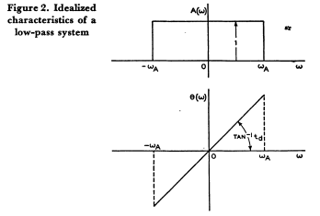
Filters
Filters are used in signal processing to reduce noise and to smooth out signals.
The Bode plot to your left, illustrates the allowed signal magnitude and phase for an ideal low pass filter (LPF).
An LPF does not allow any signal to pass that exceeds its cutoff frequency.

Slide 14
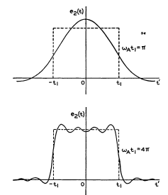
Filters (cont.)
The dotted line is the input signal, while the output signal from the LPF is overlayed above the input.
Note that with a smaller cutoff frequency we get a much smoother waveform, and the signal becomes inverted (switches from DC to AC).

Slide 15
Fourier Transform Application
Let $e_{1}(t)$ be our input signal and $e_{2}(t)$ be the output signal.
Consider the phasor:
$$E_{n}=\frac{2}{T}\int_{−\frac{T}{2}}^{\frac{T}{2}}{e^{−jnω_{1}t}}e_{1}\left(t\right)dt$$
And let the transmission frequency function of our LPF be:
$$A(nω_{1})=A(nω_{1})e^{jnω_{1}}$$

Slide 16
Fourier Transform Application (cont.)
Let our input signal be: $(T={\frac{2π}{ω}}_{1})$
$$e_{1}(t)=\frac{1}{2}\sum_{−∞}^{∞}{e^{jnω_{1}t}}\frac{2}{T}\int_{−\frac{T}{2}}^{\frac{T}{2}}{e^{−jnω_{1}t}}e_{1}\left(t\right)dt$$
$$e_{1}(t)=\frac{1}{2π}\sum_{−∞}^{∞}{e^{jω_{n}t}}Δω\int_{−∞}^{∞}{e^{−jω_{n}t}}e_{1}\left(t\right)dt$$
$$e_{1}(t)=\frac{1}{2π}\int_{−∞}^{∞}{e^{jω_{n}t}}dω\int_{−∞}^{∞}{e^{−jω_{n}t}}e_{1}\left(t\right)dt$$
Note we now have the input as the product of the Inverse Fourier Transform and the Fourier Transform respectively.

Slide 17
Fourier Transform Application (cont.)
Then our output response will be:
$$e_{2}\left(t\right)= \sum_{−∞}^{∞}{A(nω_{1})E_{n}e^{jnω_{1}t}}$$
We rewrite the output response to get:
$$e_{2}\left(t\right)=\frac{1}{2π}\int_{−∞}^{∞}{e^{jωt}A\left(ω\right)dω}\int_{−∞}^{∞}{e^{−jωt}e_{1}\left(t\right)dt}$$
If we take the Fourier Transform of both sides, we get:
$$E_{2}\left(ω\right)=A\left(ω\right)E_{1}(ω)$$
Thus, we can get the output response to our system quite simply if we know the transmission frequency of our LPF.

Slide 18
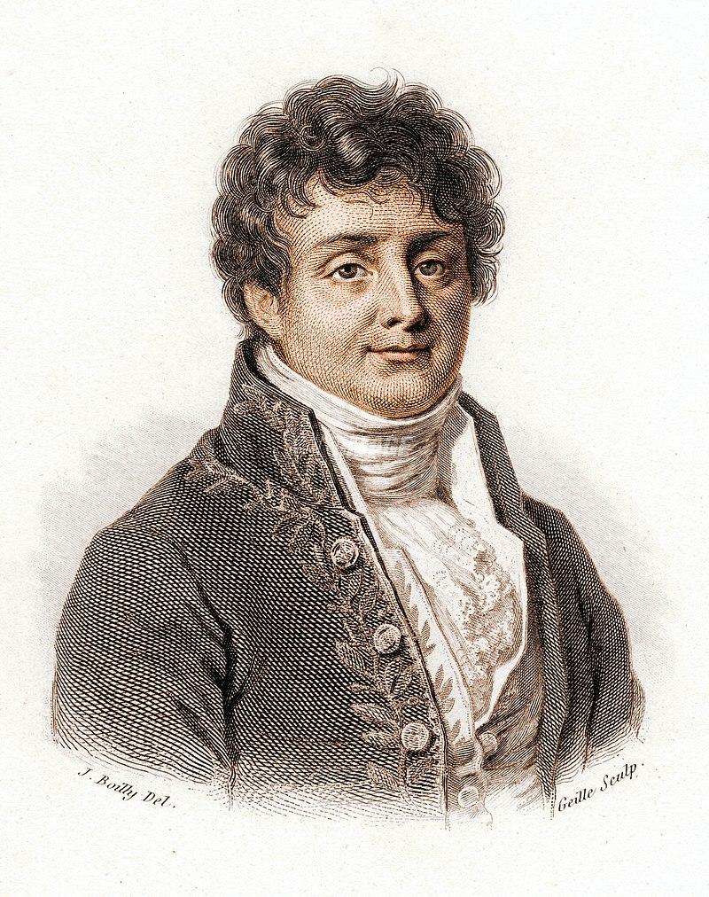
Who is Joseph?
Joseph Fourier,
Creator of the Fourier Series!

Slide 19
References
[1] I. Grattan-Guinness and J. B. J. Fourier, Joseph Fourier, 1768-1830. Cambridge: MIT Press, 1972.
[2] W. L. Sullivan, "Analysis of systems with known transmission-frequency characteristics by Fourier integrals," in Electrical Engineering, vol. 61, no. 5, pp. 248-256, May 1942, doi: 10.1109/EE.1942.6436277.

