Slide 1
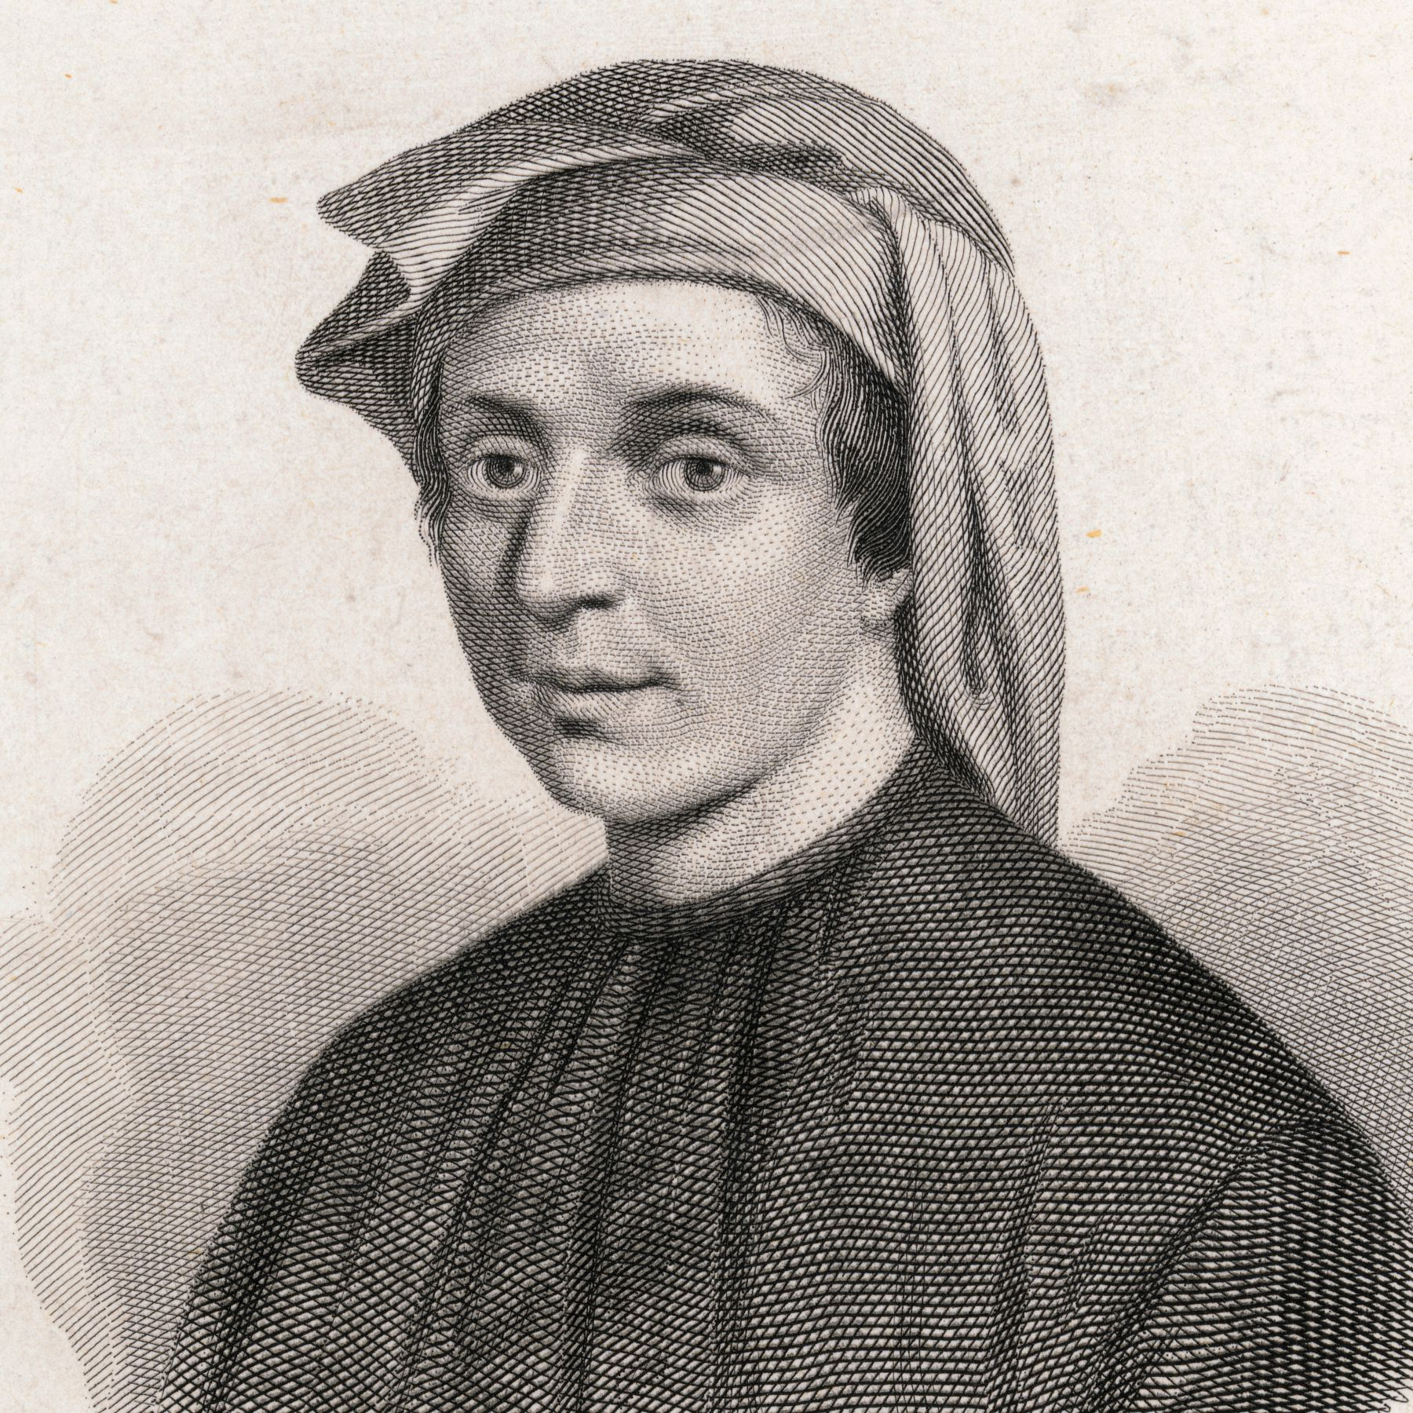
That’s me
By Eric

Slide 2
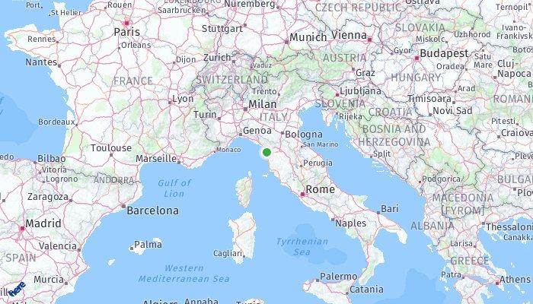
Biography
Born around 1170 in Pisa
Most of my life in Pisa
Father: Guglielmo Bonacci
Mother: Alessandra Bonacci
Traveled to many places including, Egypt, Syria, Greece, Sicily, and Provence

Slide 3
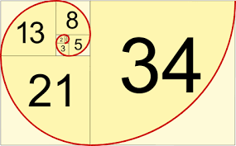
Liber Abaci
“Book of Calculation”
Devoted to arithmetic and elementary algebra
Introduction to Hindu-Arabic numeration System (zero)
Explanation of major contribution to algebra by al-Khowarizmi and Abu Kamil
One of my famous work
Sequence
1,1,2,3,5,8,13,21,34,……
Generated by sum of the two preceding numbers.
Rabbit problem
Golden Ratio

Slide 4
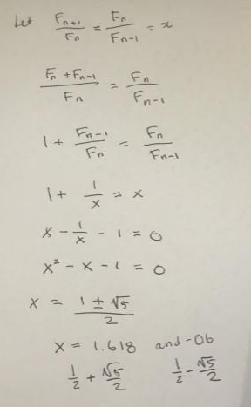
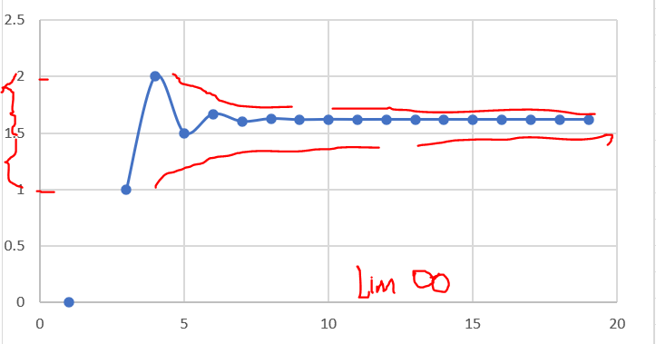

Slide 6
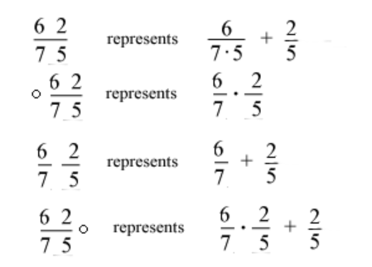
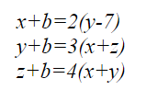
Liber Abaci
Genealogical Tree

Slide 7
Couple of other books as well
Practica Geometriae (1220)
Focuses on geometry and trigonometry with Euclidean rigor
Flos (1225)
Consists of solutions of problems by Johannes of Palermo
Liber Quadratorum (1225)
Devoted to Diophantine equations of second degree

Slide 8
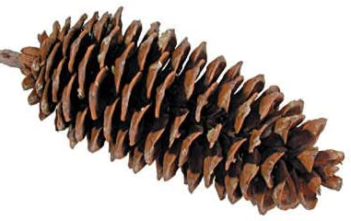
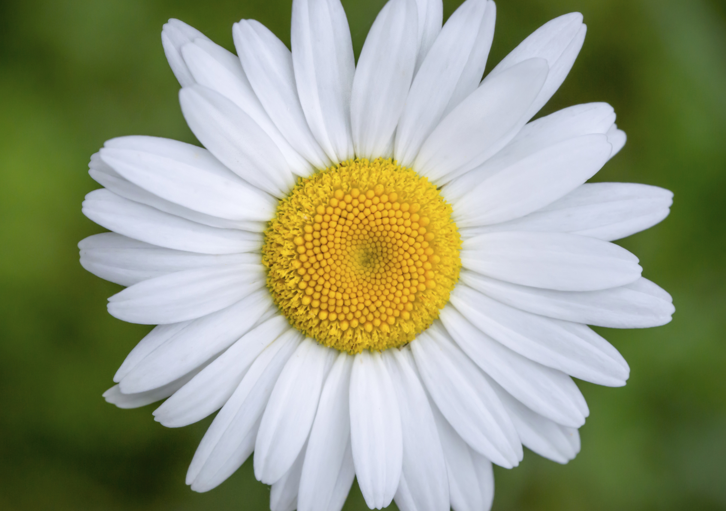
Sequences I found earlier…
It can be seen nature.
Flowers
Sunflowers
Daisy
Pinecone

Slide 9
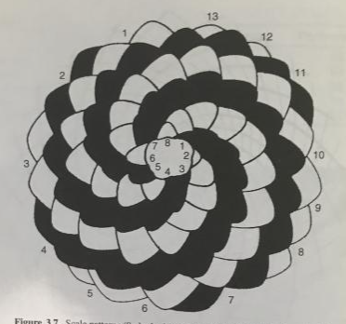
Some spirals are clockwise and rest of them are counterclockwise like on sunflower.

Slide 10
Relationship to pascal triangle?

Slide 11
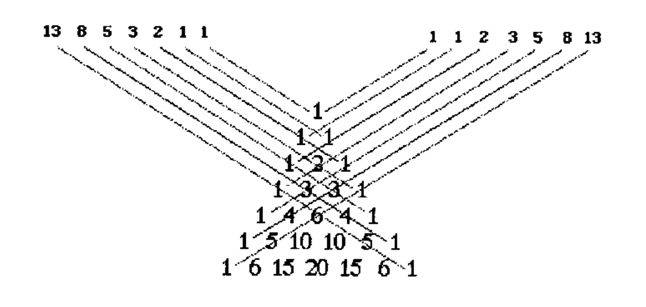
Relationship to Pascal triangle

Slide 12
Who am I ?

Slide 13
Leonardo Fibonacci

