Slide 1
Mathematician

Slide 2
Background
Born on April 21, 1652, in a small town, Amber, Basse-Auvergne, France.
Elementary schooling
Transcriber for a notary
Assistant to several attorneys

Slide 3
Change of Pace
In 1675, at the age of 23, moved to Paris
Scribe and expert arithmetic
Married and had children
Self-educated (algebra and Diophantine analysis)

Slide 4
Breakthrough
In 1682, 7 years after moving to Paris, provided a solution to a problem by Jacques Ozanam
“Find four numbers such that the difference of any two being a perfect square, in addition the sum of the first three numbers being a perfect square.”
Published solution in Journal des scavans

Slide 5
Solution
Let x, y, w, z be the four numbers such that x < y < w < z satisfying the following equations:
$$z−w=a^{2}$$
$$w −y= b^{2}$$
$$y −x= c^{2}$$
$$z −y= d^{2}$$
$$z −x= e^{2}$$
$$w −x= f^{2}$$
$$x+y+w= g^{2}$$

Slide 6
Recognition
Mathematical reputation
John-Baptiste Colbert, controller general of finance and security of state for the navy under King Louis XIV, recognized and arranged a pension for him.
Marquis de Louvois employed him.

Slide 7
Work
Louvois, the French Secretary of War, employed him to tutor his fourth son, Camille le Tellier.
Administrative post in the Ministry of War
In 1685, he was elected to the Académie Royale des Sciences

Slide 8
Halt
In 1708, suffered a stroke and recovered
Mental capacity declined
In 1719, suffered a fatal second stroke.
Death

Slide 9
Mathematical Contributions
In 1690, published Traité d’algébre on theory of equations.
Invented the notation $\sqrt[n]{x}$
Used Euclidean algorithm to find the greatest common divisor of two polynomials
Introduced the notion of ‘cascades’

Slide 10
Method of Cascades
A process by which one can find the general solution of numerical equations of the form
$$x^{n}+a_{1}x^{n−1}+a_{2}x^{n−2}+…+a_{n+1}x^{n+1}+a_{n}=0$$
Consider the polynomial
$$f\left(x\right)= x^{4}+5x^{3}−25x^{2}−65x+84=0$$

Slide 11
Step 1: Transform the equation so that the roots are positive.
Define three terms:
1. “grand hypothese” – value for which no roots of a polynomial can exceed. This number is found using the formula $(\frac{a}{c}+1)$, where a is the absolute value of the largest negative coefficient and c is the coefficient of the highest degree term.
2. “petite hypothese” - the number that is less than every root
3. “hypothese moyennes” – intermediate bounds, the roots of the cascade.

Slide 12
In our example $f\left(x\right)= x^{4}+5x^{3}−25x^{2}−65x+84=0$, let
$x= \left(\frac{a}{c}+1\right)−y$, where a = |-65| = 65 and c = 1.
So $x=\left(65+1\right)−y=66 −y$. Substitute into f(x).
$$f\left(66−y\right)= {\left(66−y\right)}^{4}+5{\left(66−y\right)}^{3}−25{\left(66−y\right)}^{2}−65\left(66−y\right)+84$$
= $y^{4} −269y^{3}+27101y^{2}−1211959y+20299110$
For simplification, let $f\left(66−y\right)=g(y)$.
Since g(y) has positive roots (by Descartes’ rule of signs), the petite hypothese of g(y) is 0.

Slide 13
$$g\left(y\right)=y^{4} −269y^{3}+27101y^{2}−1211959y+20299110$$
The grand hypothese of f(x) is 66. That is, all real roots are less than or equal to 66. The grand hypothese of g(y) is 1211960. That is, no roots of g(y) cannot exceed 1211960.
Step 2: Take the ‘derivatives’ of g(y). That is, by the following methods:
Multiply every term of the equation by the exponent of the unknown variable and divide by the unknown.
Do the same with the second equation formed from the first until an equation of the first degree is obtained.

Slide 14
$$g\left(y\right)=y^{4} −269y^{3}+27101y^{2}−1211959y+20299110=0$$
$$g^{′}\left(y\right)=4y^{3}−807y^{2}+54202y−1211959=0$$
$$g^{′′}\left(y\right)=12y^{2}−1614y+54202=0$$
$$g^{\left(3\right)}\left(y\right)=24y−1614=0$$
Step 3: Solve the equation g(y). In his Traité d’algébre, he stated that roots of an equation are separated by the roots of its cascade. That is, if bounds on the roots of g’(y) can be found, then the roots of g(y) can be found. Similarly, if bounds on the roots of g’’(y) can be found, then the roots of g’(y) can be found. Since all cascades after step 1 has positive roots, each cascade has a petite hypothese of 0.

Slide 15
In this example, we will solve for the roots of
$g^{′}\left(y\right)=4y^{3}−807y^{2}+54202y−1211959=0.$
That is, 63, 67, and 71. Then the roots of g(y) is contained in the intervals (0,63), (63,67), (67,71), and (71,1211960), where each interval contains one root.
Compute the values of g(y) in the intervals such that g(y) = 0.
In (0,63), g(62) = 0, therefore, y = 62 is the root on the interval. Similarly, in (63,67), g(65) = 0, and in (67,71), g(69) = 0. Lastly, in (71,1211960), g(73) = 0.

Slide 16
Therefore, the roots of g(y) are y = 62, y = 65, y = 69, and y = 71.
Substitute the roots of g(y) into x = 66 – y to find the roots of f(x).
Hence, the roots of f(x) are x = 4, x = 1, x = – 3, x = – 7.

Slide 17
Famous Theorem
Although his Method of Cascading is deemed as his most important contribution to Mathematics, he is known more for his famous theorem that states:
Let f be a function that is continuous on the closed interval [a,b] and differentiable on the open interval (a,b) with f(a) = f(b). Then there is a number c in (a,b) such that f’(c) = 0.

Slide 19
Relation Between Theorem and Cascade
https://www.desmos.com/calculator/qtzamwcdrk

Slide 20
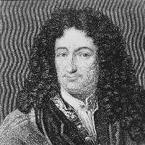
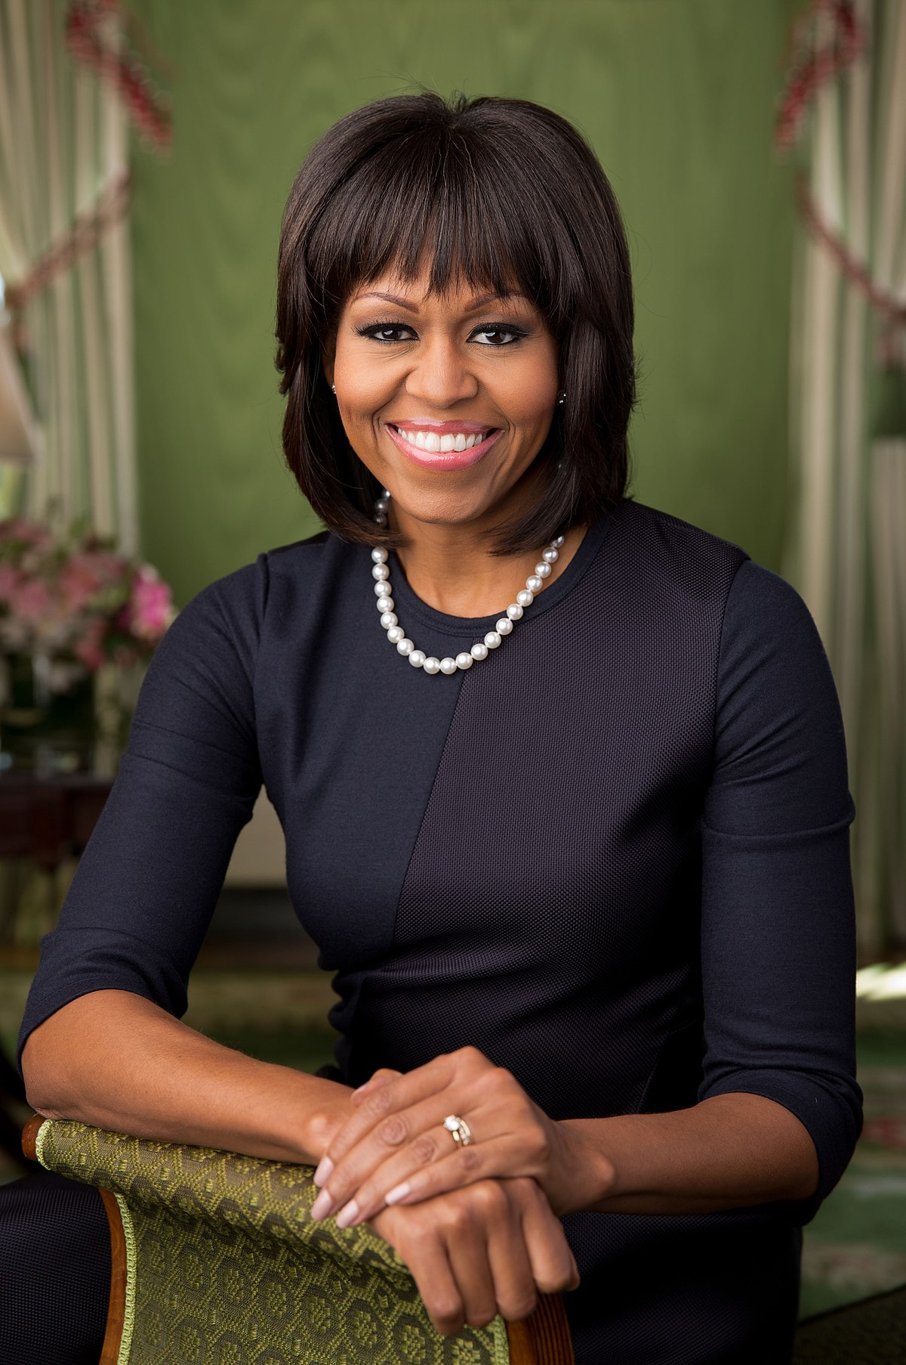
Who am I?
HINT:
Rolling in the Deep~

Slide 21
Michel Rolle

Slide 22
Extension of Rolle’s Contribution
The Rolle’s theorem is needed to prove both the Mean Value Theorem and the Taylor series.

