Slide 1
“Mathematics is the alphabet with which god has written the universe”
-my mathematician
Sara Vincelette

Slide 2
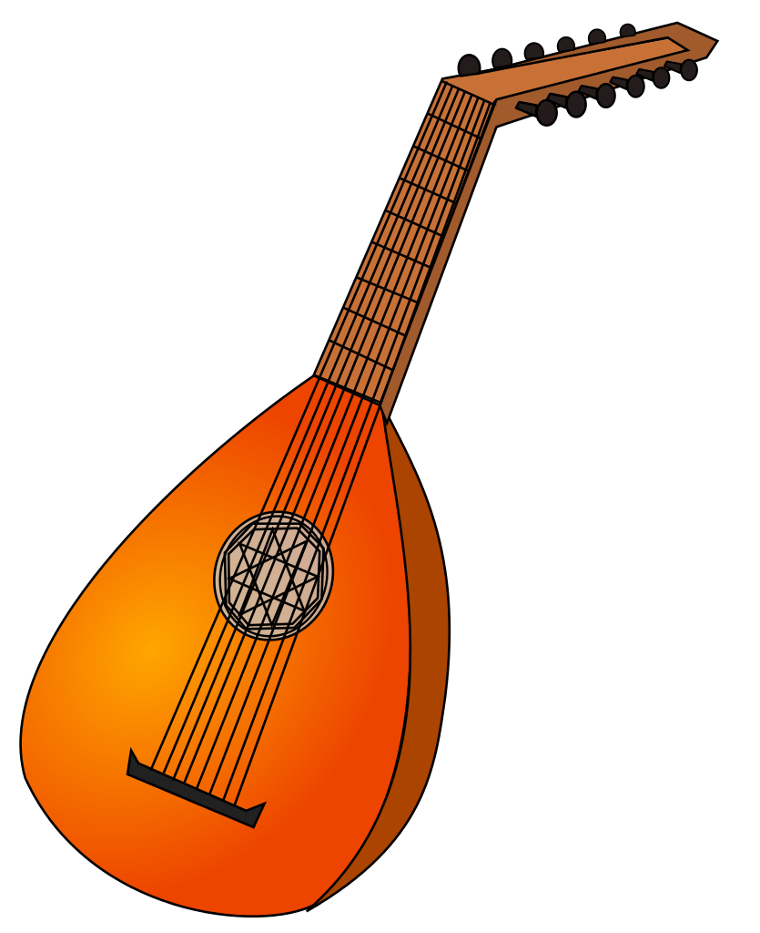
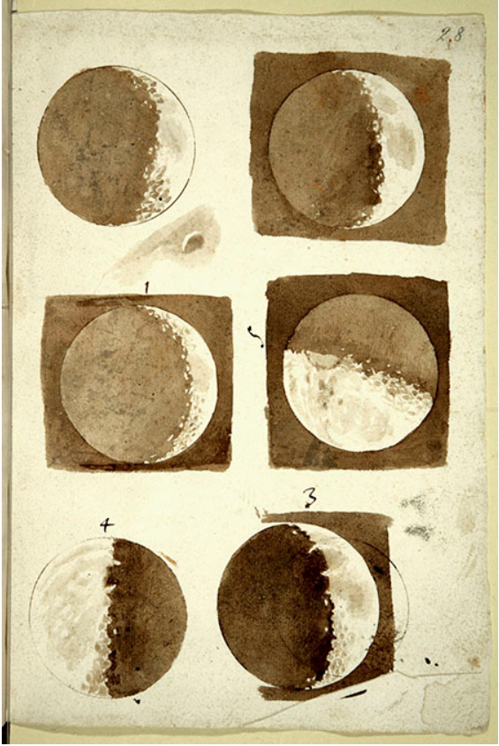
Early life
Born in Pisa, Italy on February 15th, 1564
Nobel Family
Father was a musician and mathematician
Two brothers, three sisters
Built his own toys and other machines as a child
Very talented musician and painter – aspired to be an artist
(1609)

Slide 3
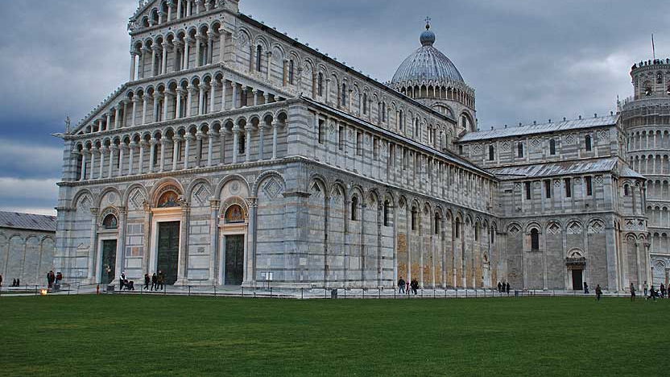
Education
Despite father struggling to support large family, he received a well-rounded education
Attended University of Pisa at age 19
Studied medicine – as his father wished
Had not yet studied mathematics at all
Longed to understand theory of drawing and music – led him to geometry
Read Euclid’s works
Obsession with math and science began
This Photo by Unknown Author is licensed under CC BY-SA-NC

Slide 4
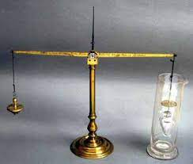
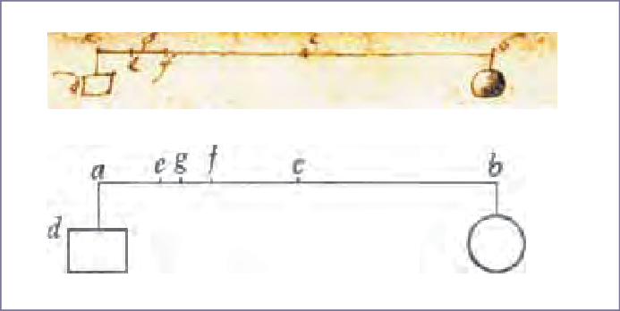
Recognition
Earliest work – “an Essay on the Hydrostatical Balance”
Eureka!
Explained how Archimedes solved Hiero’s famous question “how can we know a crown is made entirely of gold?”
Caught attention of Guido Ubaldi – most esteemed mathematician in Italy at the time
Ubaldi recognized his genius immediately
Introduced him to the right people – dukes and professors
At age 26, nominated to the lectureship of mathematics at the University of Pisa

Slide 5
“Two new Sciences” (1638)
The Problem of Scaling
Critique of Aristotle’s Law of Fall
The Pendulum
The Mathematics of Strength, Size, and Weight
A New Science of Motion
Definition of Uniform Acceleration
Law of Falling Bodies
The Parabolic Path of Projectiles

Slide 6
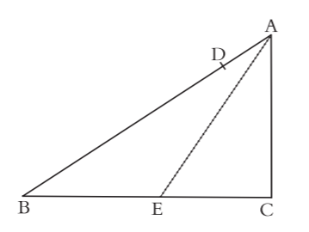
Law of falling bodies
Set out to prove what he considered obvious:
“If a body falls freely along smooth planes inclined at any angle whatsoever but of the same height, the speeds which it has when reaching the bottom are equal, provided that all impediments are removed.”

Slide 7
Law of falling bodies
Defined Uniform Motion as: “A motion is said to be uniformly accelerated when, starting from rest,
it acquires equal increments of speed during equal time intervals.”
Theorem 1, Proposition 1:
The time in which any space is traversed by a body starting from rest and
uniformly accelerated is equal to the time in which that same space would be traversed by the same body moving at a uniform speed whose value is one-half the highest and final speed reached during the previous
uniformly accelerated motion.

Slide 8
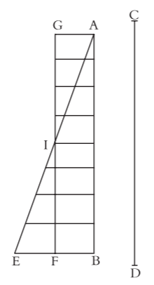
Proof

Slide 9
Further Proofs
Theorem 2, Proposition 2: If a body falls from rest with a uniformly accelerated motion, then the spaces traversed are to each other as the squares of the time intervals employed in traversing them.
Corollary 1: Hence it is clear that if we take any number of consecutive equal intervals of time, counting from the beginning of the motion, such as AD, DE, EF, FG, in which the spaces HL, LM, MN, NI are traversed, these spaces will bear to one another the same ratio as the series of odd numbers, 1, 3, 5, 7.
Corollary 2: Secondly, it follows that, starting from any initial point, if we take any two distances, traversed in any time intervals whatsoever, these time intervals bear to one another the same ratio as one of the distances to the mean proportional of the two distances.
Scholium: The above corollary has been proven for the case of vertical fall. But it holds also for planes inclined at any angle; for it is to be assumed that along these planes the velocity increases in the same ratio, that is, in proportion to the time, or, if you prefer, as the series of natural numbers.

Slide 10
Finally able to prove what he set out to

Slide 11
Last hints
“Father of Modern Science”
Other contributions:
Law of inertia
Laws of falling bodies
The pendulum
Projectile motion
The telescope
Sunspots
Mountains on the moon
Phases of Venus
Confirmation of Copernican theory of Earth’s motion
Satellites of Jupiter

Slide 12
WHO AM I?

Slide 13
GALILEO GALILEI

Slide 14
Works Cited
Drinkwater Bethune, J. E. (1829). The Life of Galileo Galilei. William Hyde & Company.
Galilei, G., & Finocchiaro, M. A. (2008). The Essential Galileo. Hackett Publishing.
Note: Both are books, however, The Essential Galileo contains a comprehensive collection
of Galileo’s translated mathematical papers that he himself once published- and that is what
I used in place of a “Mathematical Article”

