Slide 1
She walks in beauty
-- Diary of AAB

Slide 2
Once upon a time...
2 January 1815
10 December 1815
25 April 1816
Marriage of Mom and Dad
I was born in London, England
Dad left England
Mathematician & poet
Not a happy marriage
No one really loved me...
And never to return alive.
19 April 1824
5 June 1833
8 July 1835
Dad died
Mom taught me on her own
I got married
At Missolonghi
Charles Babbage and his Analytical Engine
Lord William King

Slide 3
“The training of a young lady was completely up to her parents, and particularly her mother.”
“My feelings toward my mother were more akin to awe and admiration than love and affection. The familiarity of mother and daughter never subsisted between them, there was always a degree of repulsion and distrust although they were proud of each other.”

Slide 4
Once upon a time...
2 January 1815
10 December 1815
25 April 1816
Marriage of Mom and Dad
I was born in London, England
Dad left England
Mathematician & poet
Not a happy marriage
No one really loved me...
And never to return alive.
19 April 1824
5 June 1833
8 July 1835
Dad died
I met the person that changed my life
I got married
At Missolonghi
Charles Babbage and his Analytical Engine
Lord William King

Slide 5
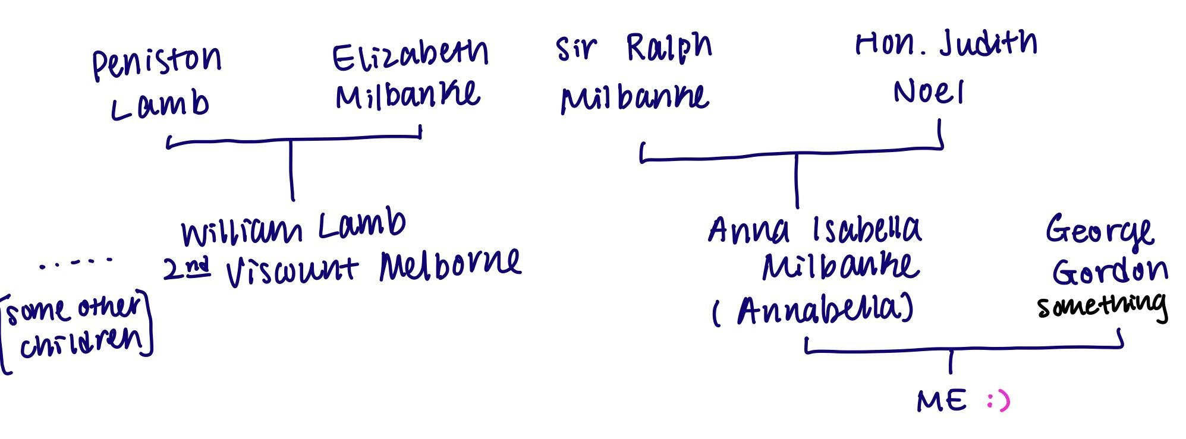
The family ...

Slide 6
Once upon a time...
June 1840
October 1842
August 1843
Learning Math with De Morgan
L.F.Menabrea’s memoir
I translated Menabrea’s memoir
Yes, THE De Morgan
On the Analytical machine
With notes 3 times longer than the paper
November 1844
June 1851
27 November 1852
I met Andrew Crosse
Diagnosed with cervical cancer
I died at age of 36
British scientist
Even before my mom

Slide 7
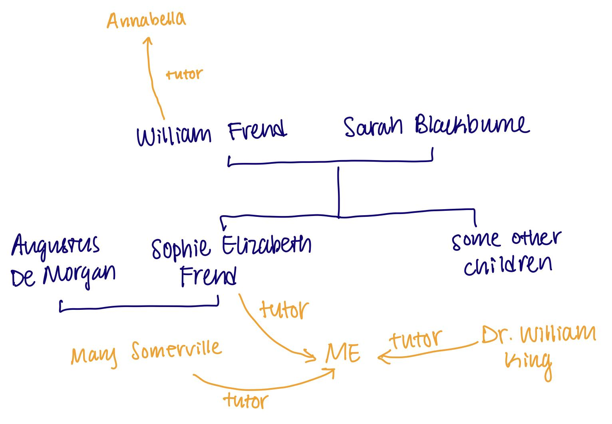
… And the friends

Slide 8
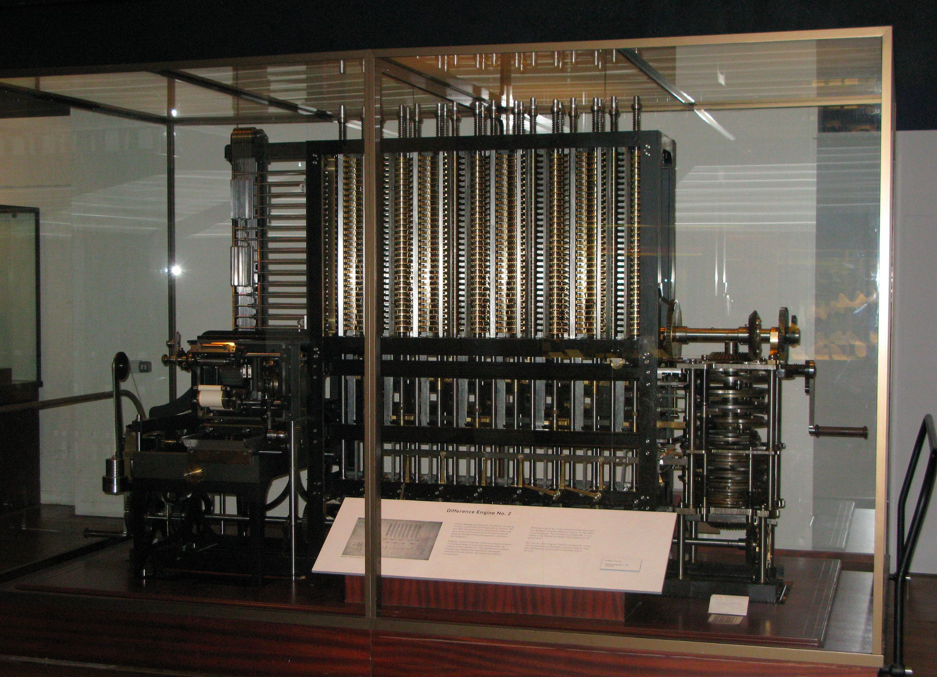
Charles Babbage and his magical machines
The Difference Engine
Started 1819 and completed 1822
Used to tabulate polynomial values
Newton's method of divided differences
https://teacher.desmos.com/activitybuilder/custom/61aef27677031351e85ecfbc

Slide 9
Charles Babbage and his magical machines
The Analytical Engine
Described in 1837
It has a memory, an arithmetic unit
Using analytical engine to calculate the Bernoulli numbers
Never built, but would run correctly

Slide 10
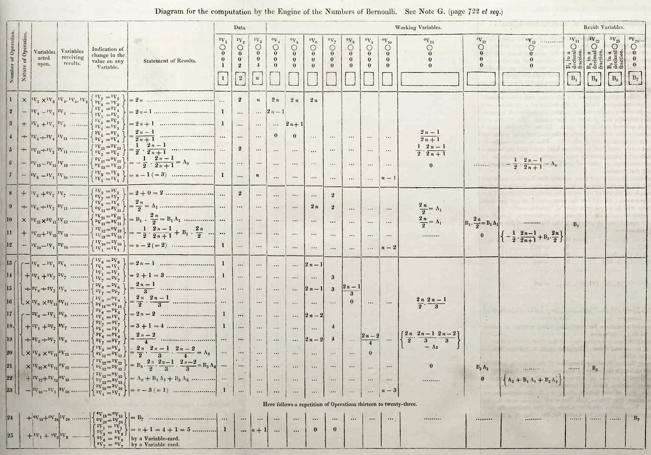

Slide 11
“[The Analytical Engine] can do whatever we know how to order it to perform. It can follow analysis; but it has no power of anticipating any analytical relations or truths.”

Slide 12
Are you ready for a game?

Slide 13
Additional sources if you are interested ...
Make sure you unblock the urls
https://www.wolframcloud.com/obj/user-e57fdc7a-843a-48ba-8e5d-7bf5f8581c8b/adathemedmathexploration/bernoullinumbers.nb
https://findingada.com/blog/2016/10/09/explore-ada-lovelaces-bernoulli-program-with-wolfram/
https://mathworld.wolfram.com/BernoulliNumber.html
https://www.youtube.com/watch?v=s6-lN62Q_z8

